Slide 1


Slide 2

Chapter 15
Algorithms for Query Processing and Optimization
Copyright © 2004 Pearson Education, Inc.

Slide 3
0. Introduction to Query Processing (1)
Query optimization: the process of choosing a suitable execution strategy for processing a query.
Internal representation of a query
  Query Tree

Slide 4
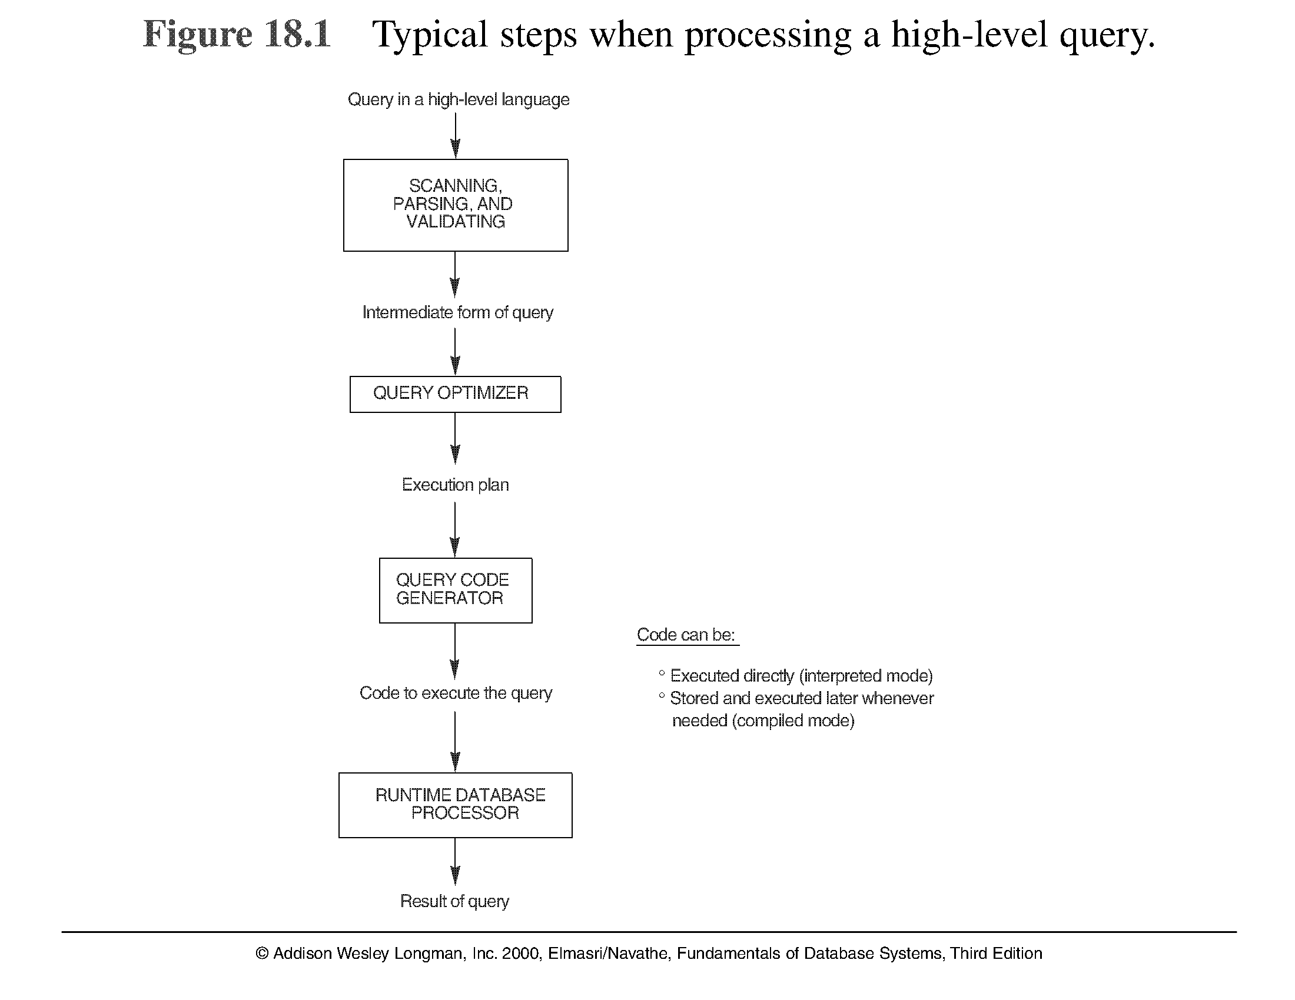
Introduction to Query Processing (2)
Note: The above figure is now called Figure 15.1 in Edition 4

Slide 5
1. Translating SQL Queries into Relational Algebra (1)
Query block: the basic unit that can be translated into the algebraic operators and optimized.
A query block contains a single SELECT-FROM-WHERE expression, as well as GROUP BY and HAVING clause if these are part of the block.
Nested queries within a query are identified as separate query blocks.
Aggregate operators in SQL must be included in the extended algebra.

Slide 6
Translating SQL Queries into Relational Algebra (2)
SELECT LNAME, FNAME
FROM EMPLOYEE
WHERE SALARY > ( SELECT MAX (SALARY)
FROM EMPLOYEE
WHERE DNO = 5);
SELECT LNAME, FNAME
FROM EMPLOYEE
WHERE SALARY > C
SELECT MAX (SALARY)
FROM EMPLOYEE
WHERE DNO = 5
π_{LNAME, FNAME} (σ_{SALARY>C}(EMPLOYEE))
ℱ_{MAX SALARY} (σ_{DNO=5} (EMPLOYEE))

Slide 7
7. Using Heuristics in Query Optimization(1)
Process for heuristics optimization
The parser of a high-level query generates an initial internal representation;
Apply heuristics rules to optimize the internal representation.
A query execution plan is generated to execute groups of operations based on the access paths available on the files involved in the query.
The main heuristic is to apply first the operations that reduce the size of intermediate results.
E.g., Apply SELECT and PROJECT operations before applying the JOIN or other binary operations.

Slide 8
Using Heuristics in Query Optimization (2)
Query tree: a tree data structure that corresponds to a relational algebra expression. It represents the input relations of the query as leaf nodes of the tree, and represents the relational algebra operations as internal nodes.
An execution of the query tree consists of executing an internal node operation whenever its operands are available and then replacing that internal node by the relation that results from executing the operation.

Slide 9
Using Heuristics in Query Optimization (3)
Example:
For every project located in ‘Stafford’, retrieve the project number, the controlling department number and the department manager’s last name, address and birthdate.
Relation algebra:
πPNUMBER, DNUM, LNAME, ADDRESS, BDATE (((σ_{PLOCATION=‘STAFFORD’}(PROJECT))
_{DNUM=DNUMBER} (DEPARTMENT)) _{MGRSSN=SSN} (EMPLOYEE))
SQL query:
Q2: SELECT P.NUMBER,P.DNUM,E.LNAME, E.ADDRESS, E.BDATE
FROM PROJECT AS P,DEPARTMENT AS D, EMPLOYEE AS E
WHERE P.DNUM=D.DNUMBER AND D.MGRSSN=E.SSN AND
P.PLOCATION=‘STAFFORD’;

Slide 10
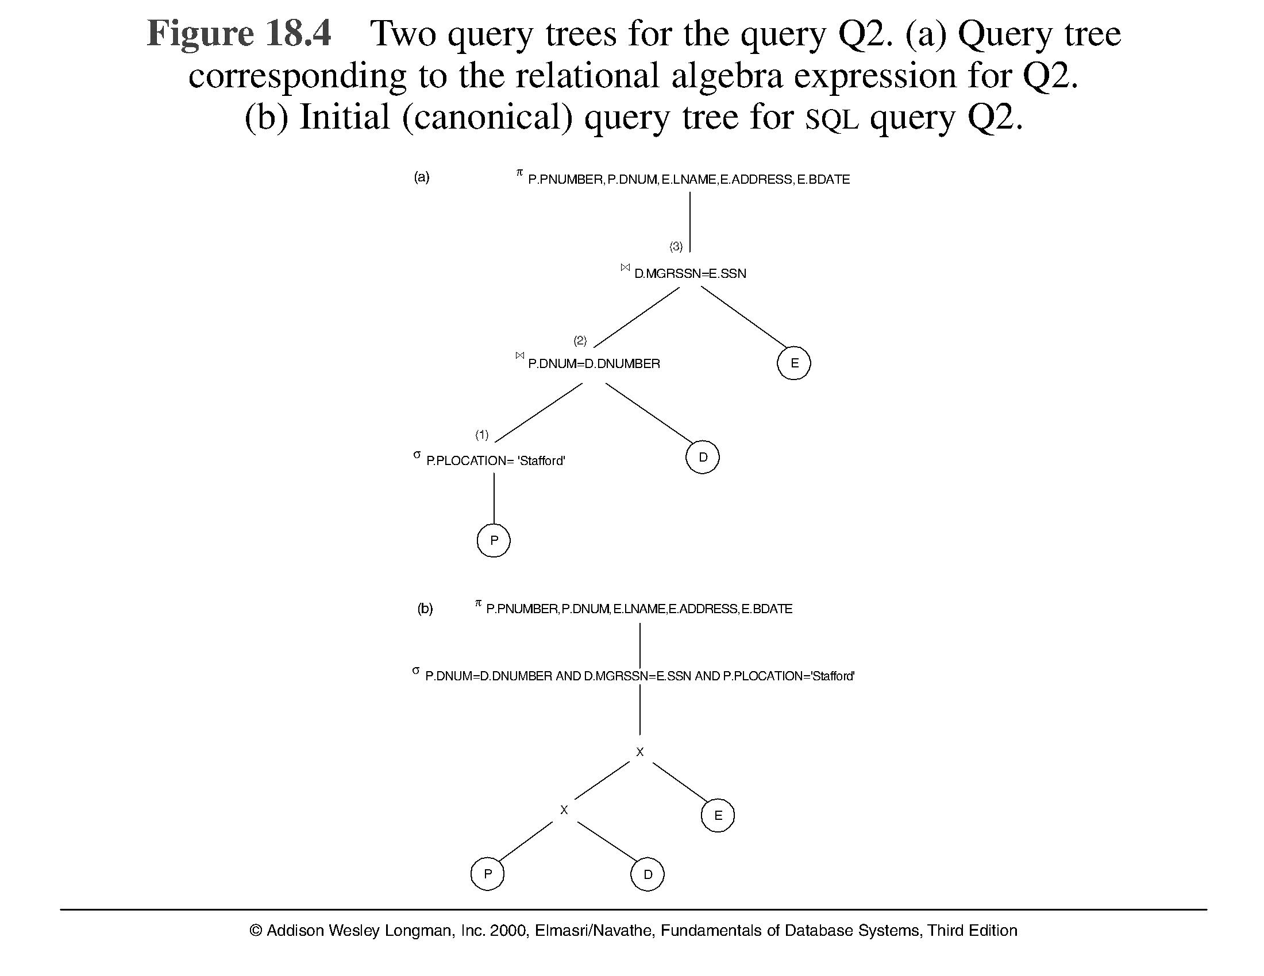
Using Heuristics in Query Optimization (4)
Note: The above figure is now called Figure 15.4 in Edition 4

Slide 11
Using Heuristics in Query Optimization (6)
Heuristic Optimization of Query Trees:
The same query could correspond to many different relational algebra expressions — and hence many different query trees.
The task of heuristic optimization of query trees is to find a final query tree that is efficient to execute.
Example:
Q: SELECT LNAME
FROM EMPLOYEE, WORKS_ON, PROJECT
WHERE PNAME = ‘AQUARIUS’ AND PNMUBER=PNO
AND ESSN=SSN AND BDATE > ‘1957-12-31’;

Slide 12
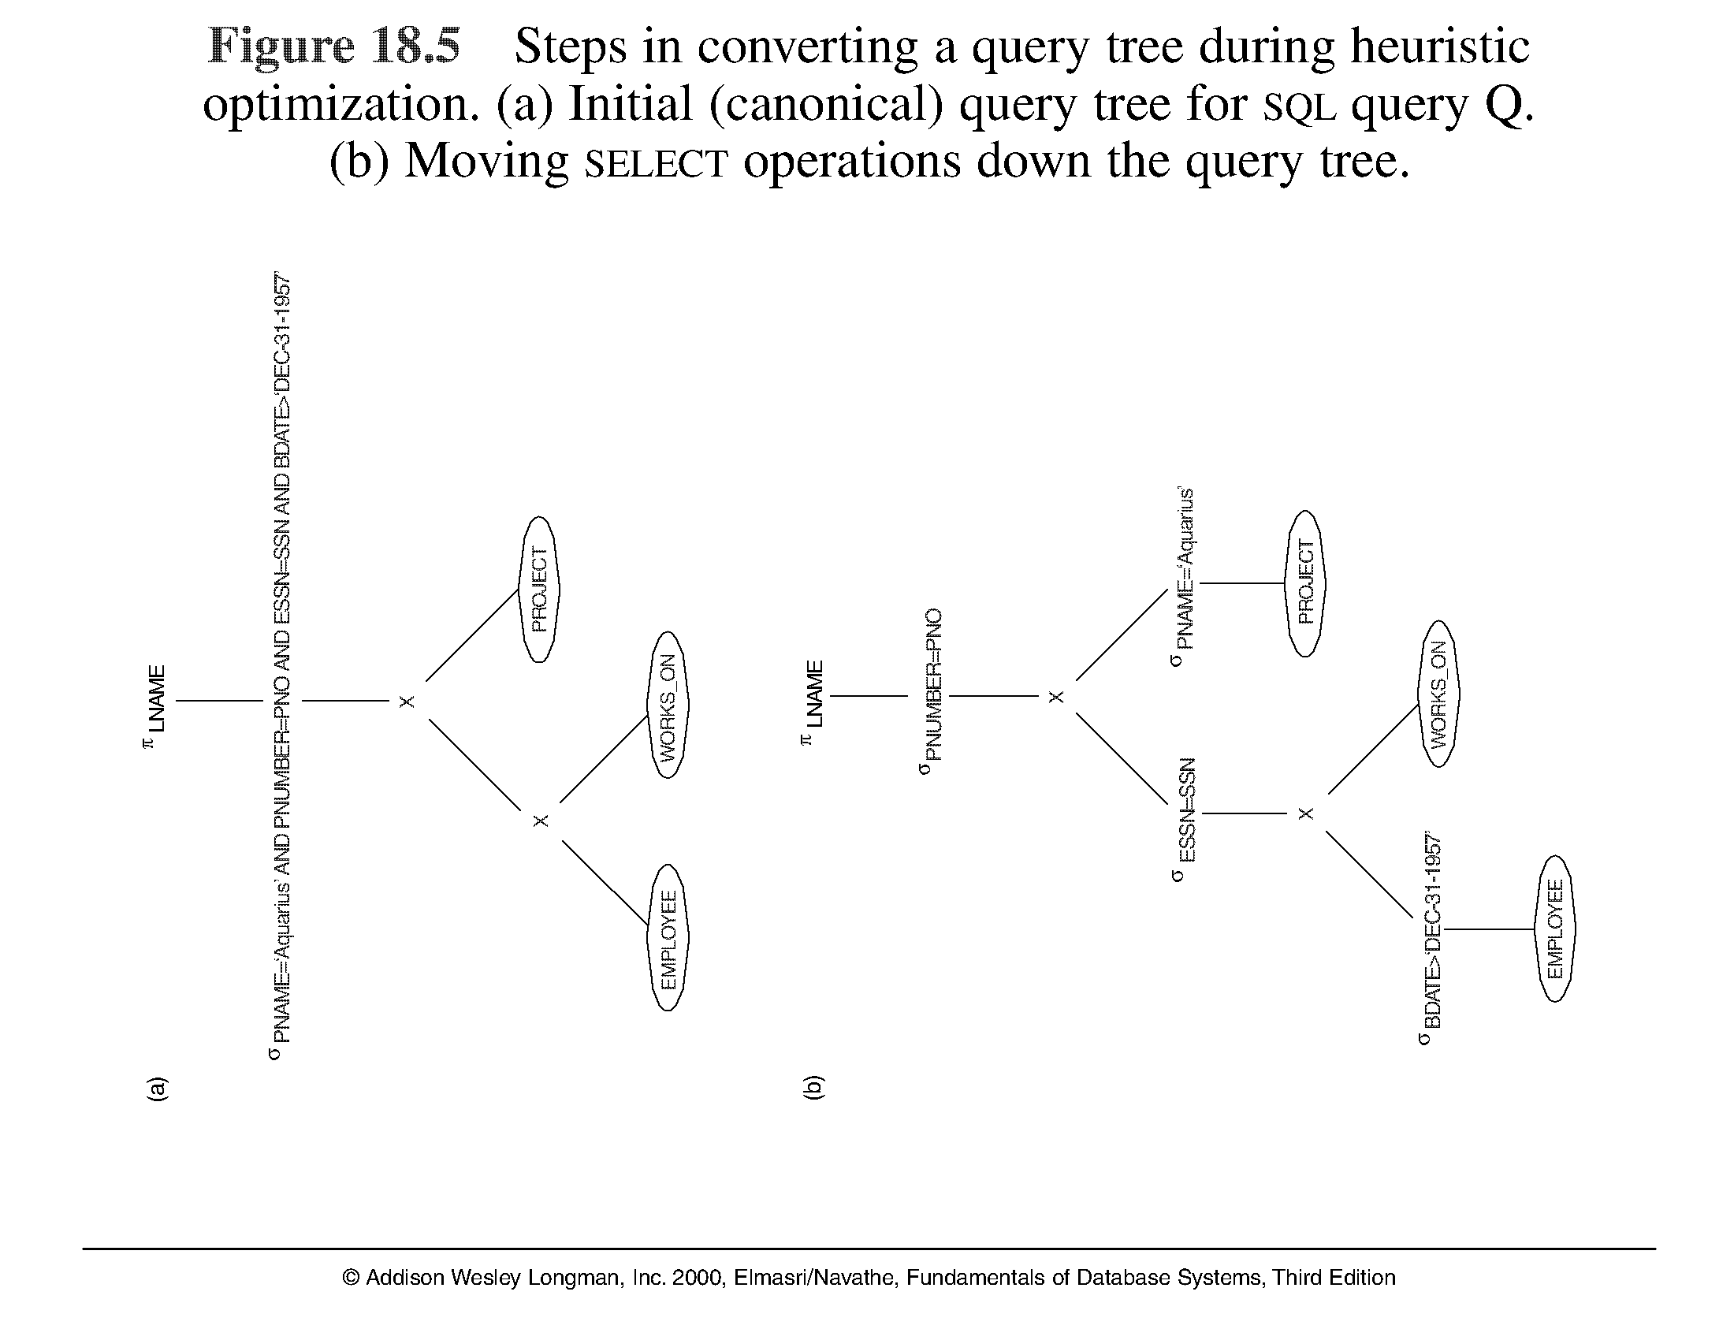
Using Heuristics in Query Optimization (7)
Note: The above figure is now called Figure 15.5 in Edition 4

Slide 13
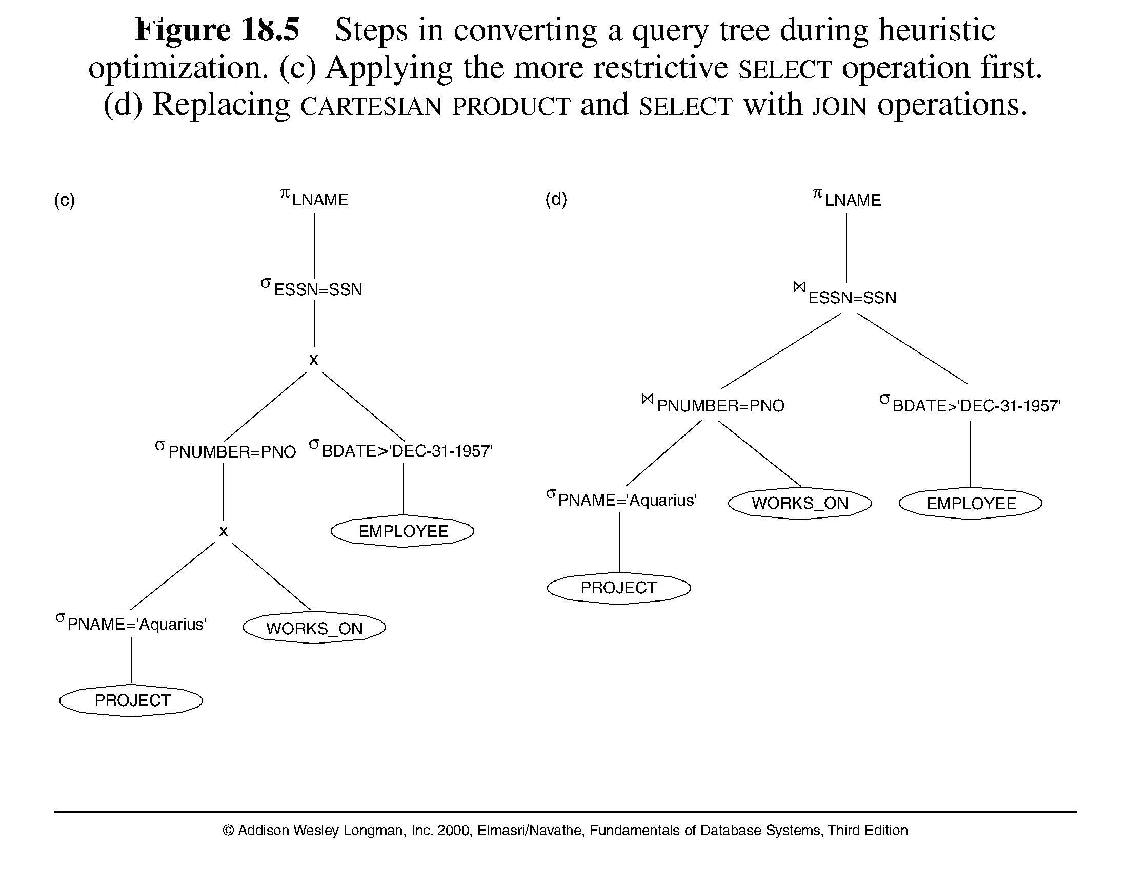
Using Heuristics in Query Optimization (8)
Note: The above figure is now called Figure 15.5(continued c, d) in Edition 4

Slide 14
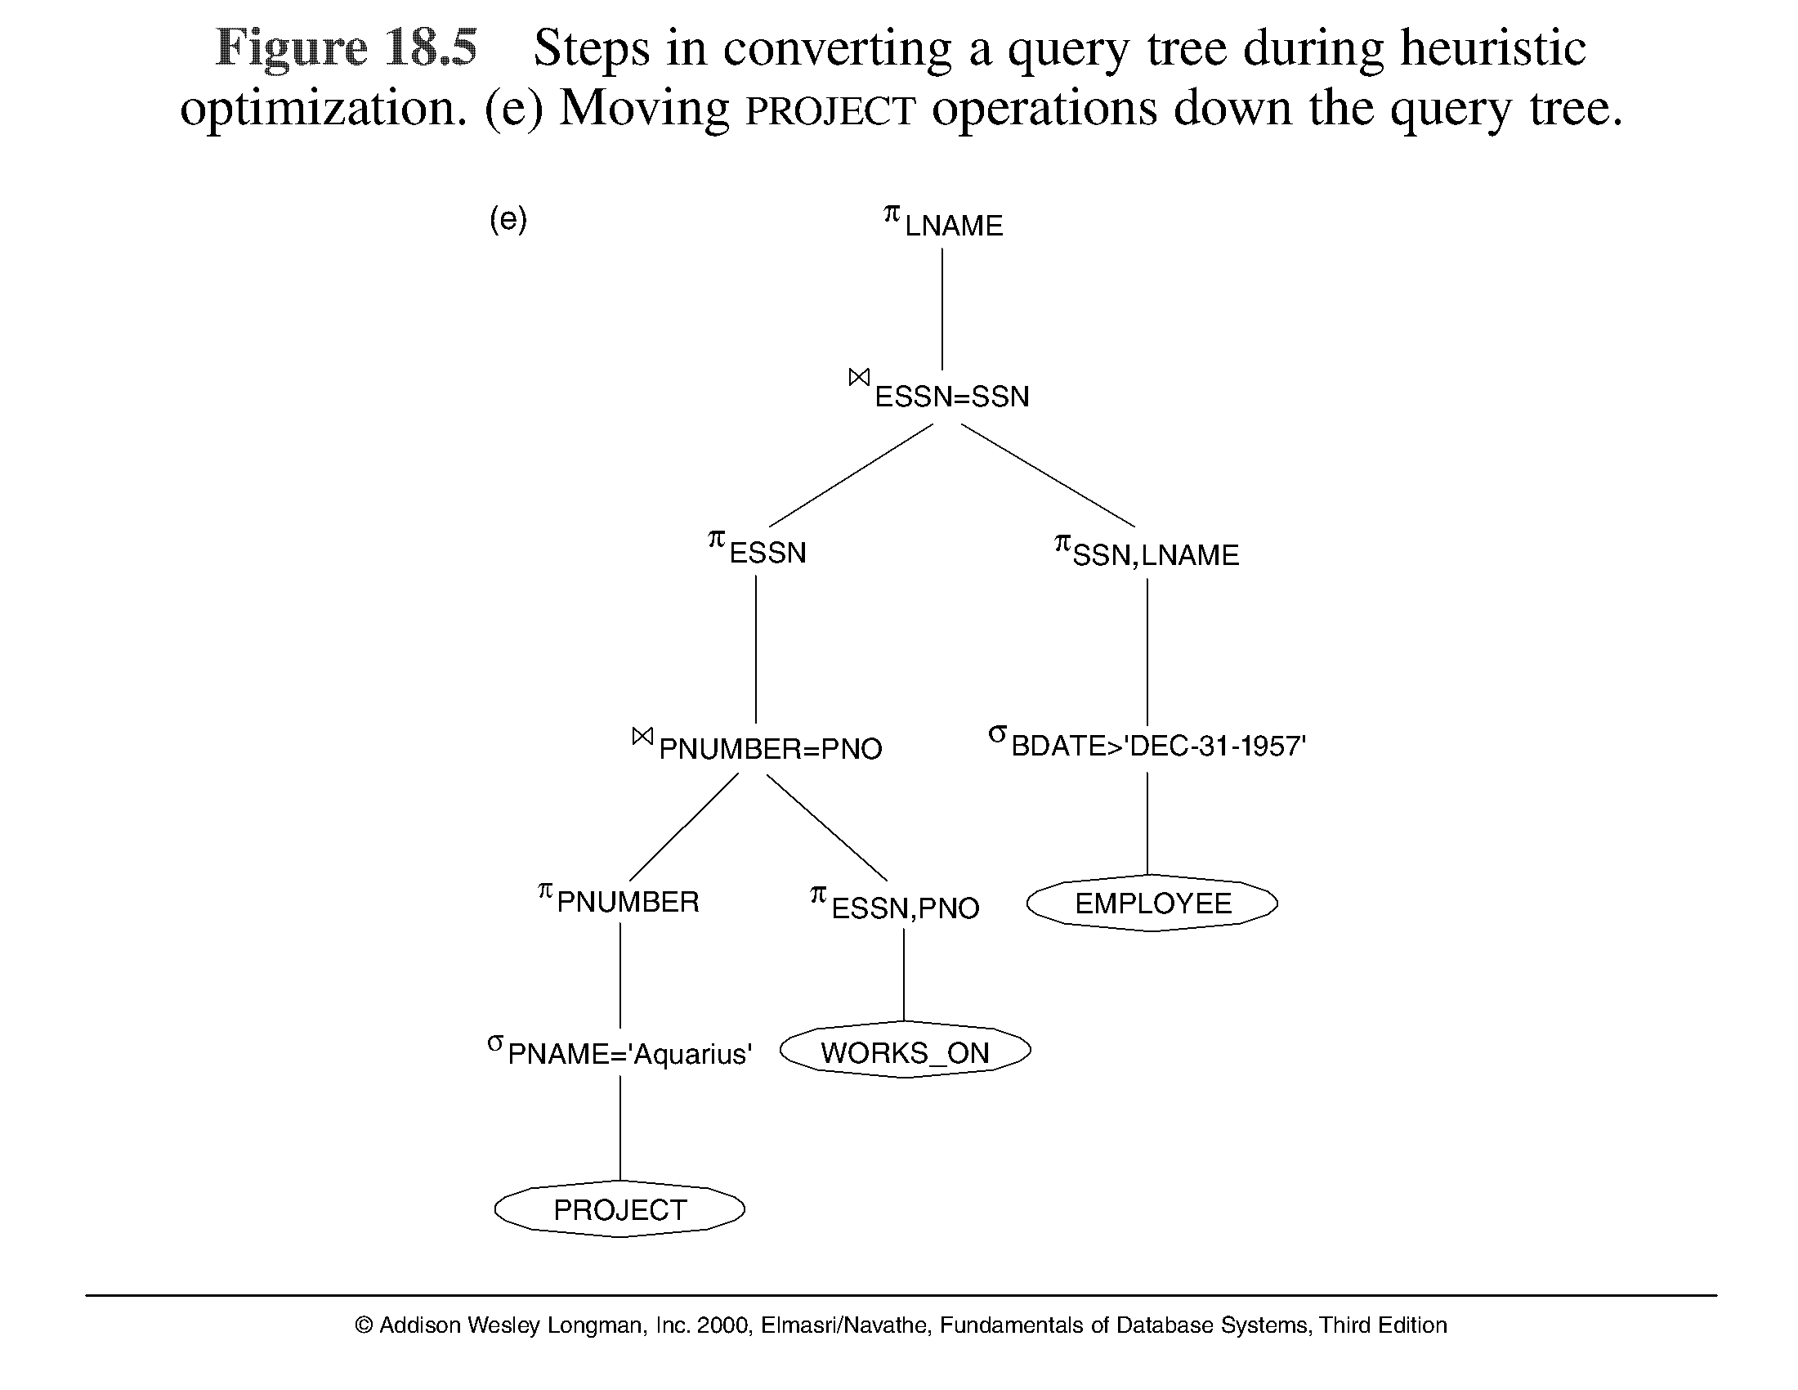
Using Heuristics in Query Optimization (9)
Note: The above figure is now called Figure 15.5(continued e) in Edition 4

Slide 15
Using Heuristics in Query Optimization (10)
General Transformation Rules for Relational Algebra Operations:
Cascade of σ: A conjunctive selection condition can be broken up into a cascade (sequence) of individual s operations: σ _{c1 AND c2 AND ... AND cn}(R) = σ_{c1} (σ_{c2} (...(σ_{cn}(R))...) )
Commutativity of σ: The σ operation is commutative: σ_{c1} (σ_{c2}(R)) = σ_{c2} (σ_{c1}(R))
Cascade of π: In a cascade (sequence) of π operations, all but the last one can be ignored:
π_{List1} (π_{List2} (...(π_{Listn}(R))...) ) = π_{List1}(R)
Commuting σ with π: If the selection condition c involves only the attributes A1, ..., An in the projection list, the two operations can be commuted:
π_{A1, A2, ..., An} (σ_{c} (R)) = σ_{c} (π_{A1, A2, ..., An} (R))

Slide 16
Using Heuristics in Query Optimization (11)
General Transformation Rules for Relational Algebra
Commutativity of ( and x ): The operation is commutative as is the x operation:
R _{C} S = S _{C} R; R x S = S x R
6. Commuting σ with (or x ): If all the attributes in the selection condition c involve only the attributes of one of the relations being joined—say, R—the two operations can be commuted as follows (_{c0} is join condition) :
σ_{c} ( R _{c0}S ) = (σ_{c} (R)) _{c0} S
Alternatively, if the selection condition c can be written as (c1 and c2), where condition c1 involves only the attributes of R and condition c2 involves only the attributes of S, the operations commute as follows:
σ_{c} ( R _{c0} S ) = (σ_{c1}(R)) _{c0} (σ_{c2} (S))

Slide 17
Using Heuristics in Query Optimization (12)
General Transformation Rules for Relational Algebra Operations (cont.):
Commuting π with (or x ): Suppose that the projection list is L = {A1, ..., An, B1, ..., Bm}, where A1, ..., An are attributes of R and B1, ..., Bm are attributes of S. If the join condition c involves only attributes in L, the two operations can be commuted as follows:
π_{L} ( R _{C} S ) = (π_{A1, ..., An} (R)) _{C} (π_{B1, ..., Bm} (S))
If the join condition c contains additional attributes not in L, these must be added to the projection list, and a final π operation is needed.

Slide 18
Using Heuristics in Query Optimization (13)
General Transformation Rules for Relational Algebra Operations (cont.):
Commutativity of set operations: The set operations υ and ∩ are commutative but – is not.
Associativity of , x, υ, and ∩ : These four operations are individually associative; that is, if θ stands for any one of these four operations (throughout the expression), we have ( R θ S ) θ T = R θ ( S θ T )
Commuting σ with set operations: The σ operation commutes with υ , ∩ , and –. If θ stands for any one of these three operations, we have
σ_{c} ( R θ S ) = (σ_{c} (R)) θ (σ_{c} (S))

Slide 19
Using Heuristics in Query Optimization (14)
General Transformation Rules for Relational Algebra Operations (cont.):
The π operation commutes with υ. π_{L} ( R υ S ) = (π_{L} (R)) υ (π_{L} (S))
Converting a (σ, x) sequence into : If the condition c of a σ that follows a x Corresponds to a join condition, convert the (σ, x) sequence into a as follows: (σ_{C} (R x S)) = (R _{C} S)

Slide 20
Using Heuristics in Query Optimization (15)
Outline of a Heuristic Algebraic Optimization Algorithm:
Using rule 1, break up any select operations with conjunctive conditions into a cascade of select ops.
Using rules 2, 4, 6, and 10 concerning the commutativity of select with other operations, move each select operation as far down the query tree as is permitted by the attributes involved in the select condition.
Using rule 9 concerning associativity of binary operations, rearrange the leaf nodes of the tree so that the leaf node relations with the most restrictive select operations are executed first in the query tree rep.
Using Rule 12, combine a cartesian product operation with a subsequent select operation in the tree into a join operation.

Slide 21
Using Heuristics in Query Optimization (16)
Outline of a Heuristic Algebraic Optimization Algorithm (cont.)
Using rules 3, 4, 7, and 11 concerning the cascading of project and the commuting of project with other operations, break down and move lists of projection attributes down the tree as far as possible by creating new project operations as needed.

Slide 22
Using Heuristics in Query Optimization (17)
Summary of Heuristics for Algebraic Optimization:
The main heuristic is to apply first the operations that reduce the size of intermediate results.
Perform select operations as early as possible to reduce the number of tuples and perform project operations as early as possible to reduce the number of attributes. (This is done by moving select and project operations as far down the tree as possible.)
The select and join operations that are most restrictive should be executed before other similar operations. (This is done by reordering the leaf nodes of the tree among themselves and adjusting the rest of the tree appropriately.)

